Slide 1
JOB SEQENCING WITH DEADLINES
NAME:G.SOWMYA
ROLL NO:22H51A0588

Slide 2
WHAT IS JOB SEQENCING?
Job sequencing with deadlines is a problem that involves scheduling a set of jobs to maximize profit while adhering to their respective deadlines. This approach assumes that each job can be completed in exactly one unit of time. The prime objective of the Job Sequencing with Deadlines algorithm is to complete the given order of jobs within respective deadlines, resulting in the highest possible profit. To achieve this, we are given a number of jobs, each associated with a specific deadline, and completing a job before its deadline earns us a profit. The challenge is to arrange these jobs in a way that maximizes our total profit.

Slide 3
ALGORITHM
function JobSequencing(jobs, n):
Step 1: Sort jobs in decreasing order of profit
sort jobs[] in decreasing order of profit
Step 2: Initialize result and slot arrays
result[] = [-1] * n # Result array to store the job sequence
slot[] = [false] * n # Slot array to keep track of occupied slots
Step 3: Iterate over each job
for i = 0 to n-1:
Find a free slot for this job (from job.deadline to 0)
for j = min(jobs[i].deadline, n)-1 down to 0:
If slot j is free, assign job i to this slot
if slot[j] == false:
result[j] = i Assign job i to result[j]

Slide 4
ALGORITHM
slot[j] = true # Mark this slot as occupied
break
Step 4: Print the result
print "Job sequence to maximize profit:"
for i = 0 to n-1:
if result[i] != -1:
print "Job", jobs[result[i]].id

Slide 5
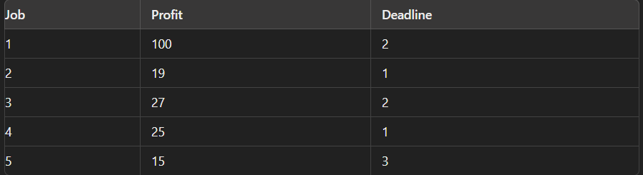
EXAMPLE
Given, 5 problems :

Slide 6
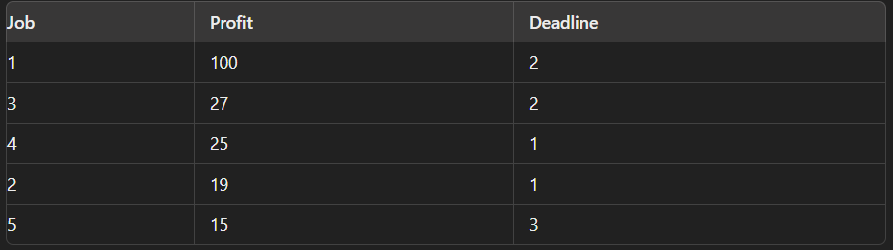
EXAMPLE
Sort the jobs in decreasing order of their profits:

Slide 7
EXAMPLE
Step 2: Initialize Result and Slot Arrays
result[]: To store the job sequence.
slot[]: To keep track of free time slots.
Initially:
result[] = [-1, -1, -1] (since there are at most 3 slots based on the maximum
deadline).
slot[] = [false, false, false] (all slots are free).
Step 3: Place Jobs in Slots
Job 1:
Profit: 100, Deadline: 2
Find the latest free slot before or on the deadline 2.
Slot 2 is free, so place Job 1 in slot 2.

Slide 8
EXAMPLE
Updated arrays:
result[] = [-1, 1, -1]
slot[] = [false, true, false]
Job 3:
Profit: 27, Deadline: 2
Find the latest free slot before or on the deadline 2.
Slot 1 is free, so place Job 3 in slot 1.
Updated arrays:
result[] = [3, 1, -1]
slot[] = [true, true, false]
Job 4:
Profit: 25, Deadline: 1
Find the latest free slot before or on the deadline 1.
Slot 1 is already occupied, so Job 4 cannot be scheduled.

Slide 9
EXAMPLE
Updated arrays:
result[] = [-1, 1, -1]
slot[] = [false, true, false]
Job 3:
Profit: 27, Deadline: 2
Find the latest free slot before or on the deadline 2.
Slot 1 is free, so place Job 3 in slot 1.
Updated arrays:
result[] = [3, 1, -1]
slot[] = [true, true, false]
Job 4:
Profit: 25, Deadline: 1
Find the latest free slot before or on the deadline 1.
Slot 1 is already occupied, so Job 4 cannot be scheduled.

Slide 10
EXAMPLE
No changes to arrays.
Job 2:
Profit: 19, Deadline: 1
Find the latest free slot before or on the deadline 1.
Slot 1 is already occupied, so Job 2 cannot be scheduled.
No changes to arrays.
Job 5:
Profit: 15, Deadline: 3
Find the latest free slot before or on the deadline 3.
Slot 3 is free, so place Job 5 in slot 3.
Updated arrays:
result[] = [3, 1, 5]
slot[] = [true, true, true]

Slide 11
EXAMPLE
Step 4: Output the Job Sequence
The sequence of jobs that maximizes profit is:
Job 3
Job 1
Job 5
Total Profit: 27+100+15=14227 + 100 + 15 = 14227+100+15=142
Final Answer:
The job sequence is Job 3, Job 1, Job 5 with a maximum profit of 142.

Slide 12
THANK YOU!

